Slide 1
An Introduction to the Role of Carbon Capture and Storage in Ukraine Keith Whiriskey

Slide 3
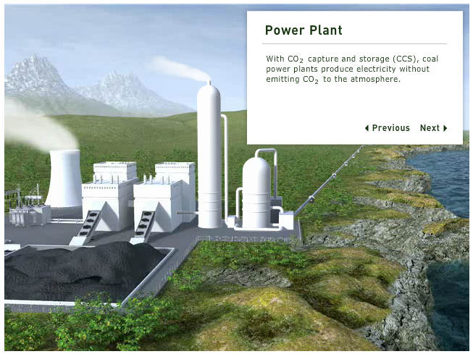
How Does CCS Work?
CCS
Fitted to Large Stationary CO₂ Sources
Energy Production
Industry

Slide 4
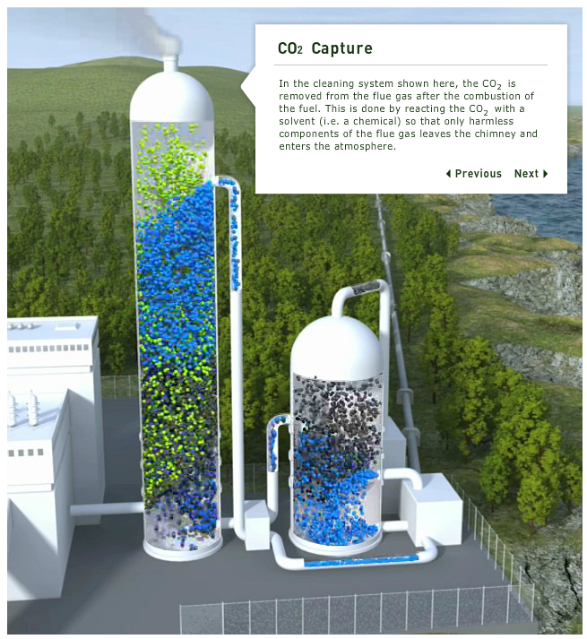
CO2 Capture
CO₂ is captured using a variety of technologies
Amine, Oxy fuel, Pre-Combustion

Slide 5
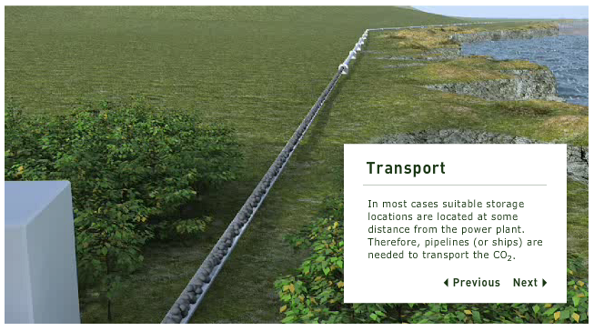
CO2 Transport
CO₂ is compressed and transported in pipelines

Slide 6
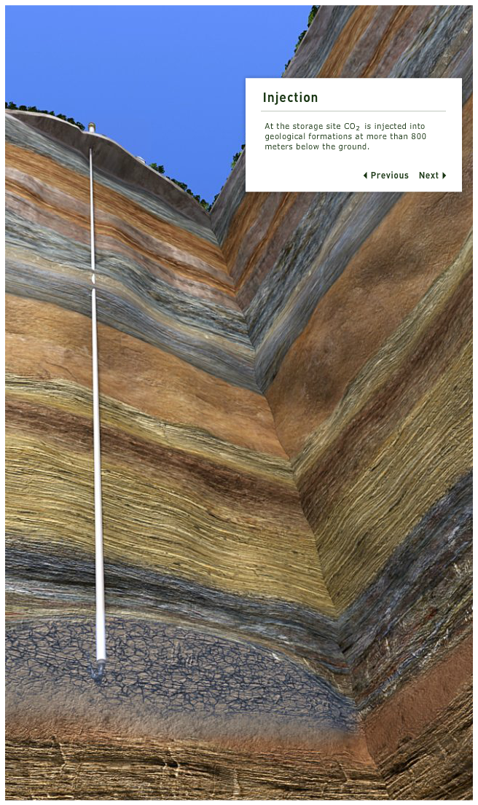
CO2 Storage
CO₂ is permanently stored underground. Using techniques similar to the oil and gas industry

Slide 7
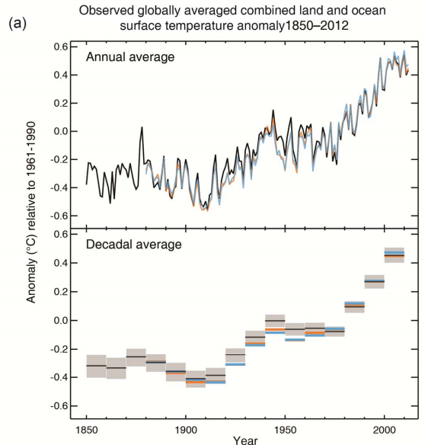
The World Has Been Warming

Slide 8
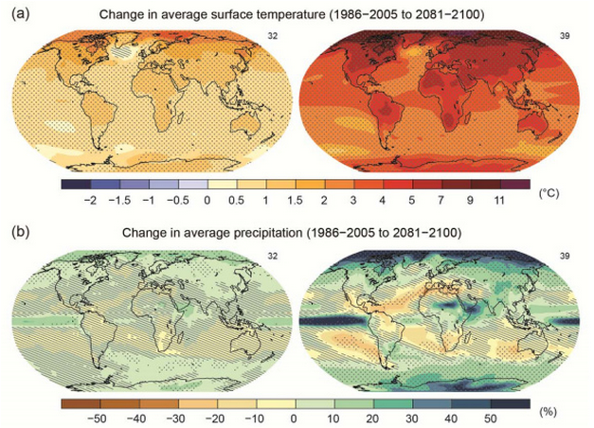
And is Set to Get Much Warmer
Notes:
Most aspects of climate change will persist for many centuries even if emissions of CO2 are stopped," the authors write.
"It is very likely that the Arctic sea ice cover will continue to shrink and thin and that Northern Hemisphere spring snow cover will decrease during the 21st century as global mean surface temperature rises."
"Global glacier volume will further decrease." That's worldwide, from Greenland to the Andes.
"Global surface temperature change for the end of the 21st century is likely to exceed 1.5°C relative to 1850 to 1900 ... and more likely than not to exceed 2°C" for typical warming scenarios. That's a lowball, too.
"The contrast in precipitation between wet and dry regions and between wet and dry seasons will increase..." Read: Drier deserts and flooded wetlands.

Slide 9
And More Acidic

Slide 10
95% certain that humans are the "dominant cause"

Slide 11
Global Action
EU: Boarder Carbon Adjustments
China: CCS Development Taskforce
USA: No New Coal Without CCS

Slide 12
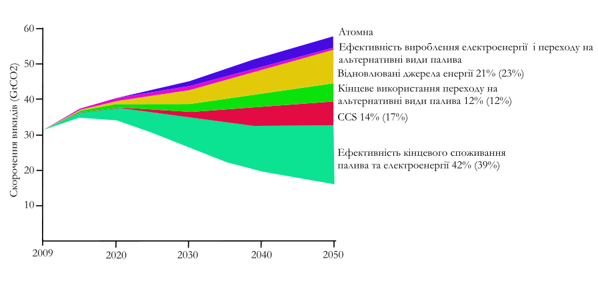
How Much CCS Do We Need

Slide 14
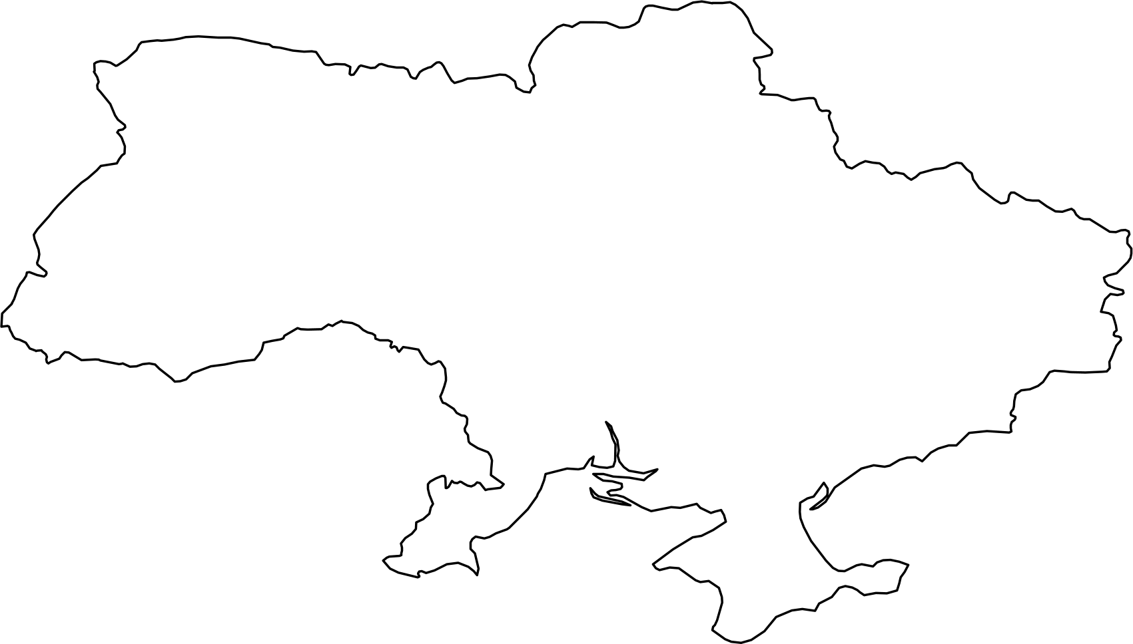
Ukraine and Global Warming

Slide 15
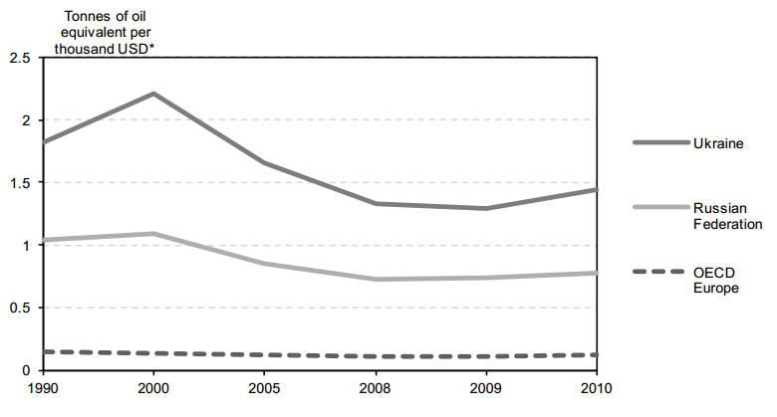
Economy Very Energy Intensive

Slide 16
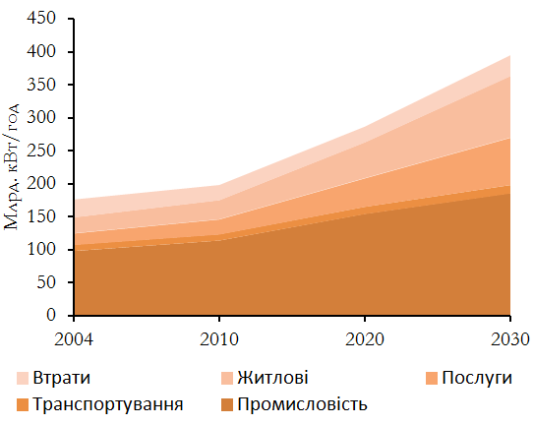
Electricity Requirements by Sector in Ukraine

Slide 17
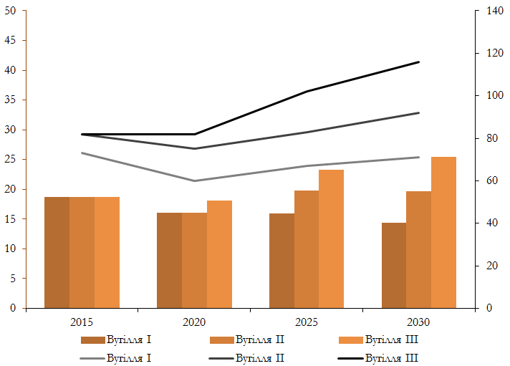
Coal Capacity Set to Increase
Coal Generation Capacity (GW)
Coal Output (TWh)

Slide 18
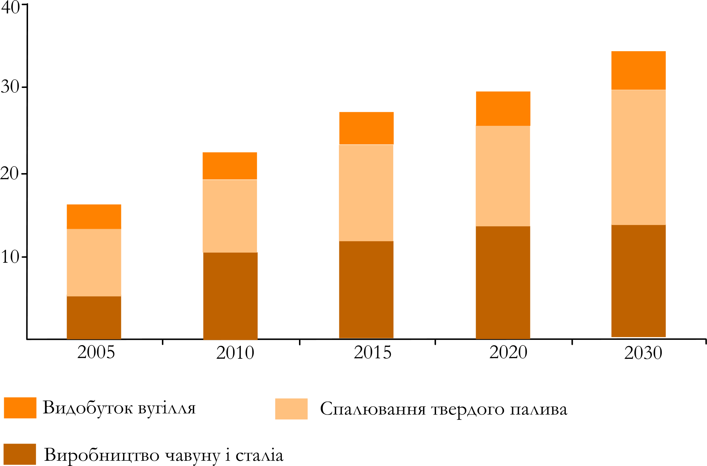
CO2 from Coal Production and Consumption
CO2 million tones

Slide 19
To roundup
Ukraine has
Energy intensive industry
CO₂ Emissions intensive industry
Increasing use of solid fuels (coal & lignite)
Growing electricity demand
Ukrainian economy and competitiveness is potentially vulnerable to global climate measures
= CCS

Slide 20
A relevant & compact CCS resource
Practical information, including technical, economic, legal, deployment, operation and public outreach
Reflecting Ukrainian political and industrial setting
Covering the major topic of CCS and providing a detailed introduction on CCS
Practical information, including

Slide 21
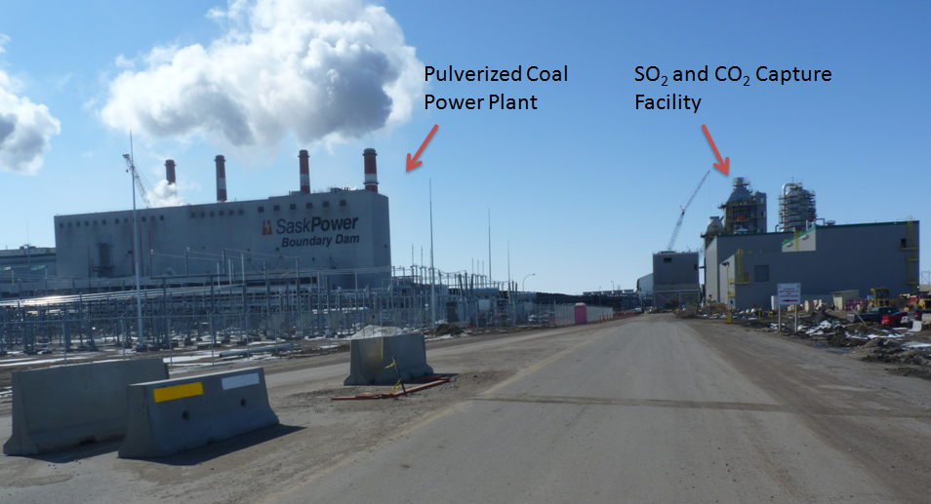
Boundary Dam CCS Facility

Slide 22
Strategic value of CCS in Ukraine
Reduce Industrial CO2 emissions
On demand low carbon electricity
High capacity credit and energy supply security
National scale CO2 reductions from single site, one-off projects
Use of indigenous Ukrainian expertise
Re-use of existing national infrastructure (electricity grid, mining operations)
Cost may be offset, especially in early projects with the use of EOR
Continued use of indigenous fuels that might otherwise be “un-burnable”

Slide 23
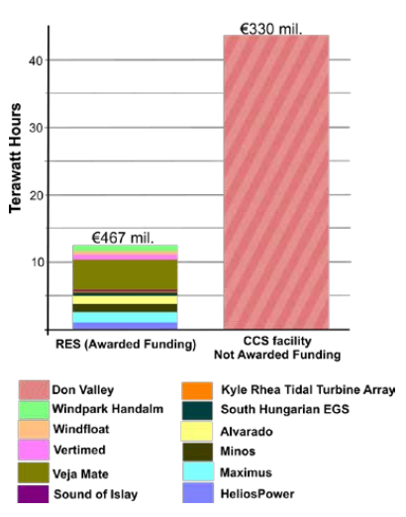
CCS Is Effective
GW hours of low-carbon electricity supplied to the grid over a 10-year period

Slide 24
What Can Be Done to Prepare Ukraine for CCS ?

Slide 25
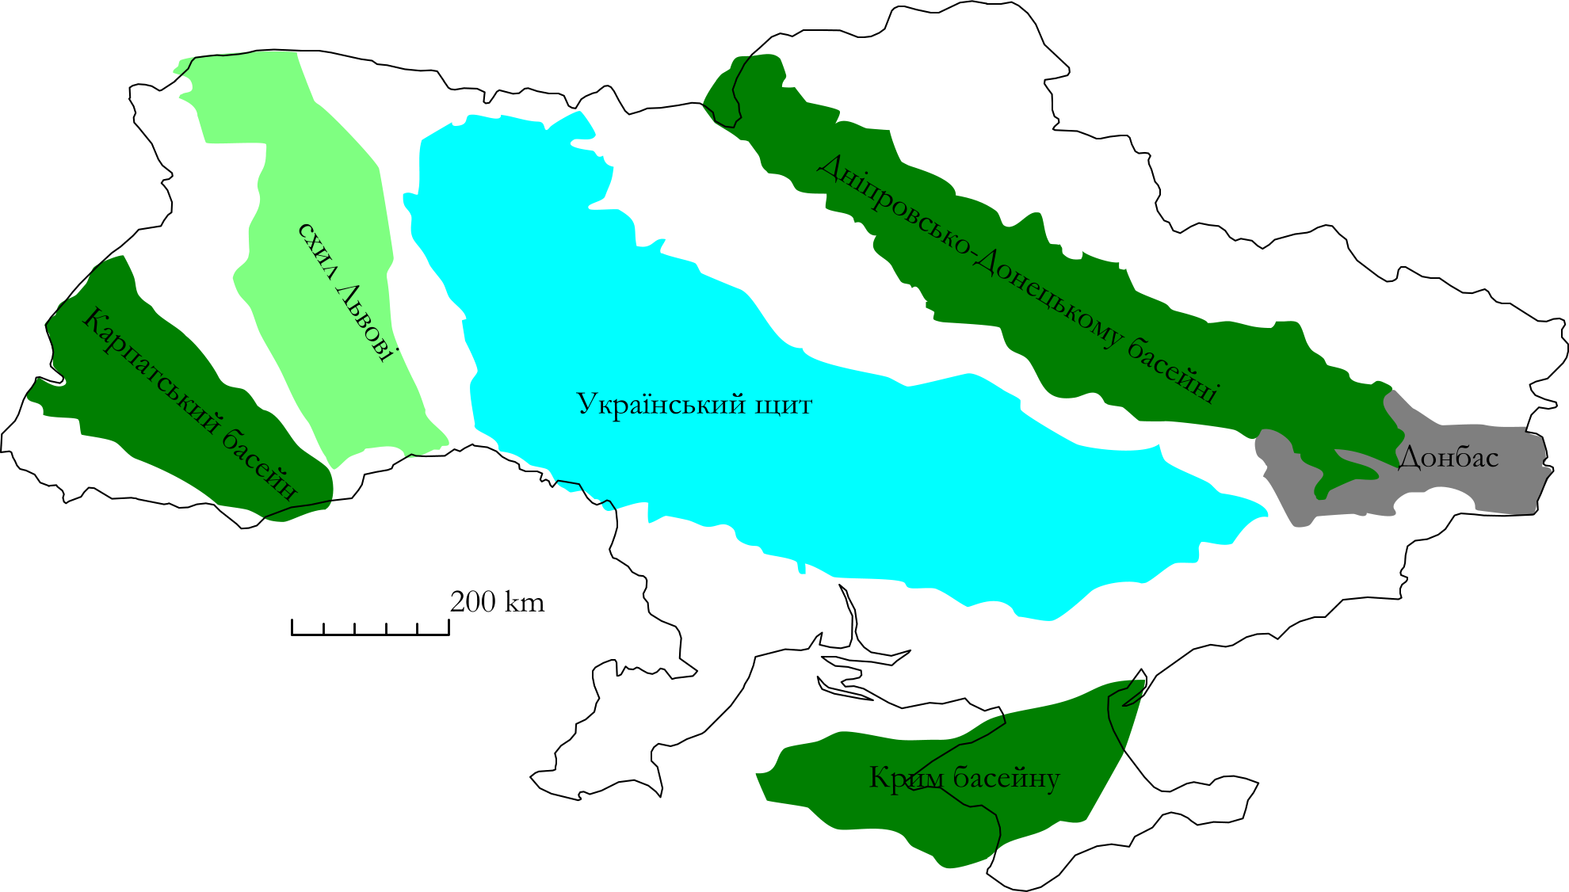
Where to Store CO2?

Slide 26
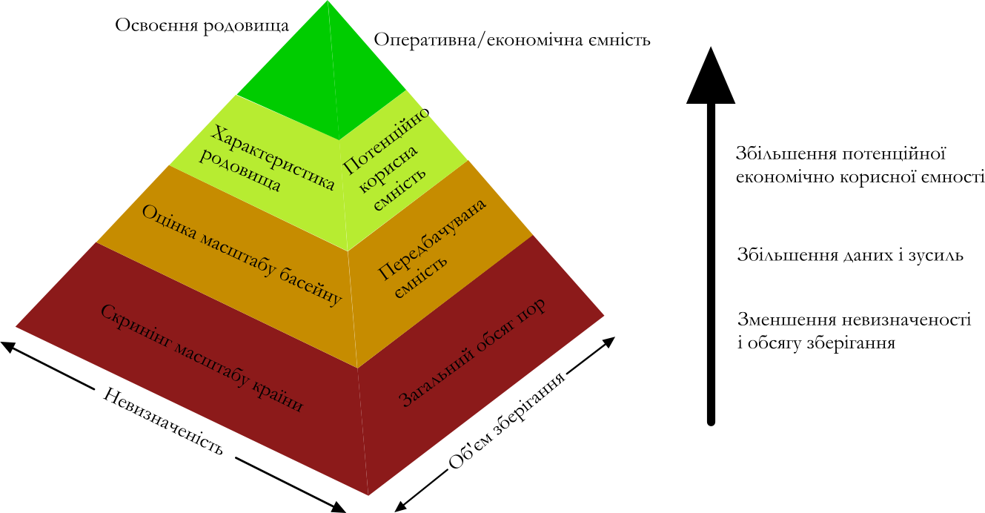
Developing Storage

Slide 27
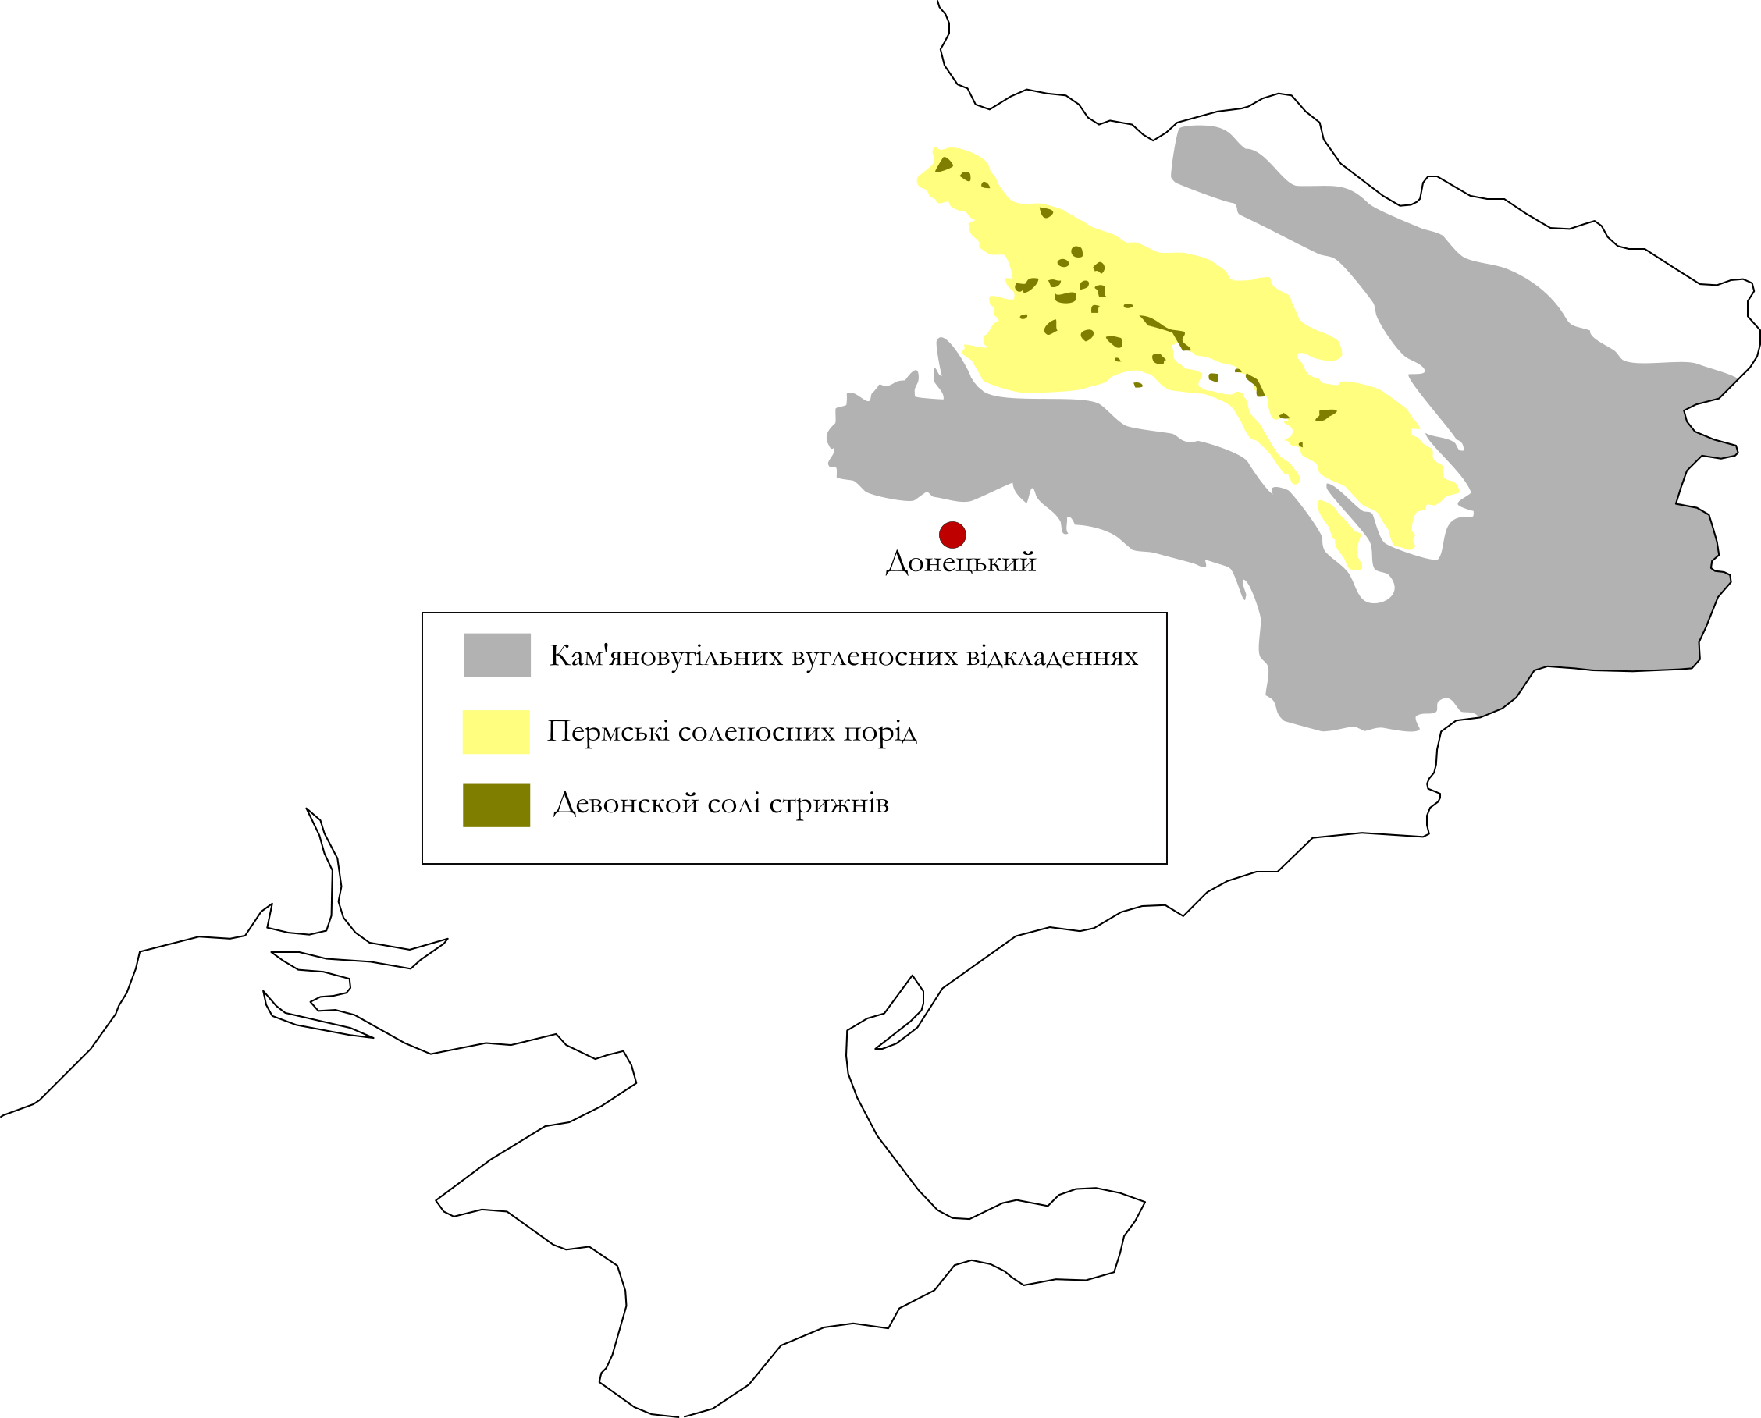
CO2 Storage Ukraine – Development Beginning

Slide 28
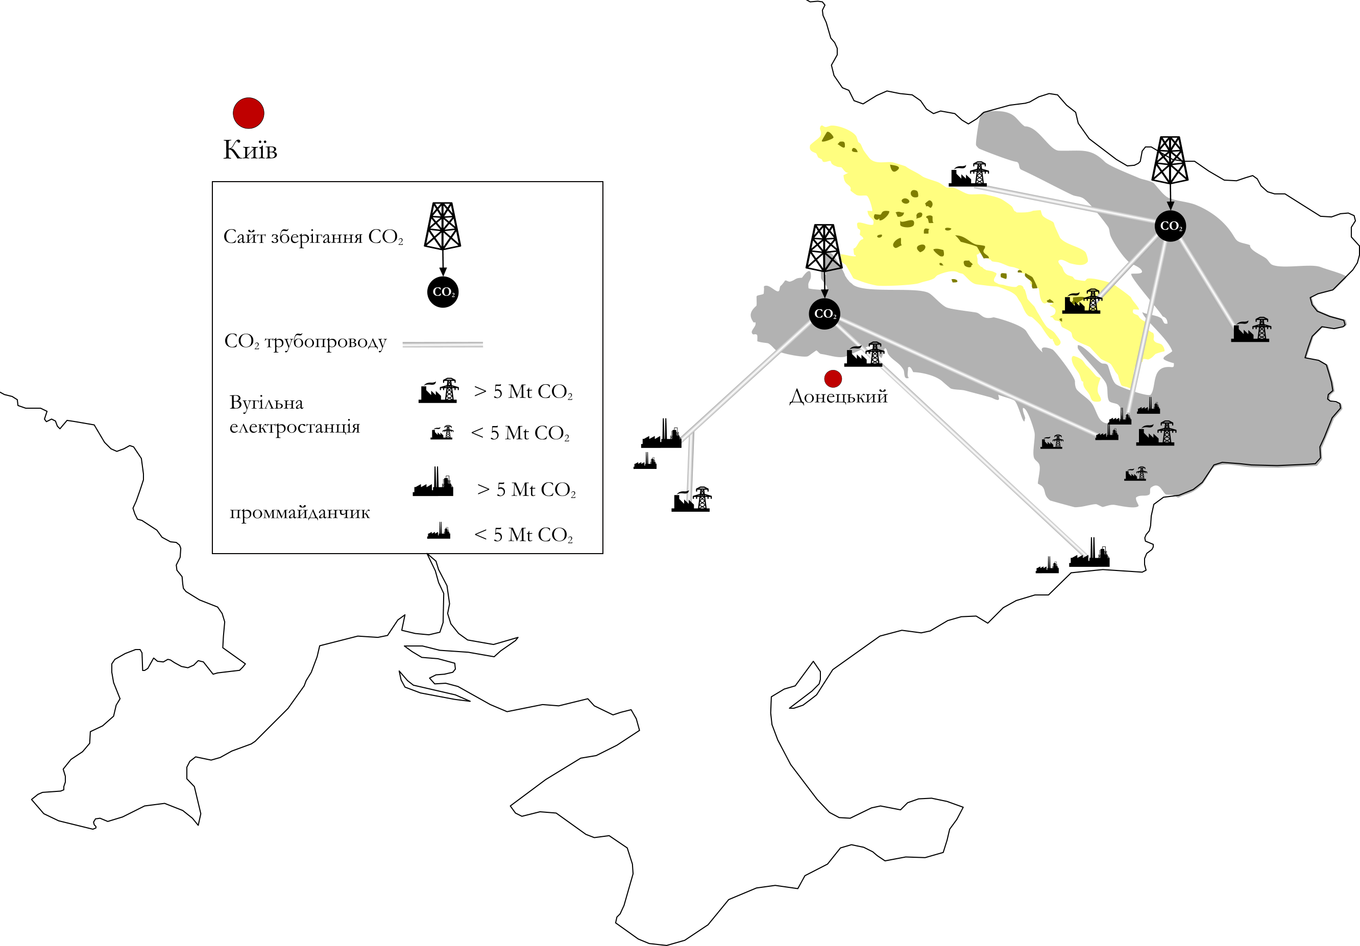
CO2 Clusters and Hub

Slide 29
Can CCS Be Profitable In Ukraine Now ?

Slide 30
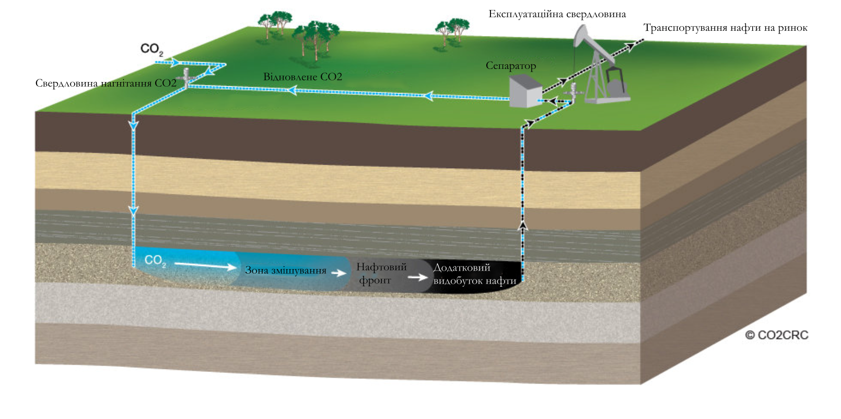
What is CO₂ EOR

Slide 31
EOR USA

Slide 32
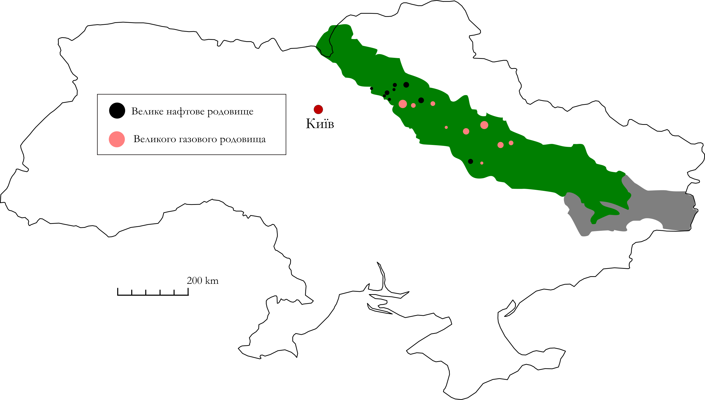
Potential for EOR in Ukrainian
Low average recovery rates
Mature fields
Complex oil charge/trapping mechanisms
Complex and poorly imaged structural geology
Relatively deep

Slide 33
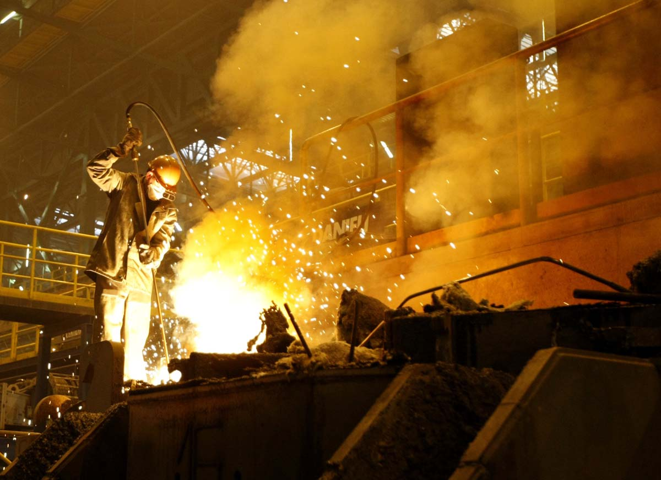

Slide 34
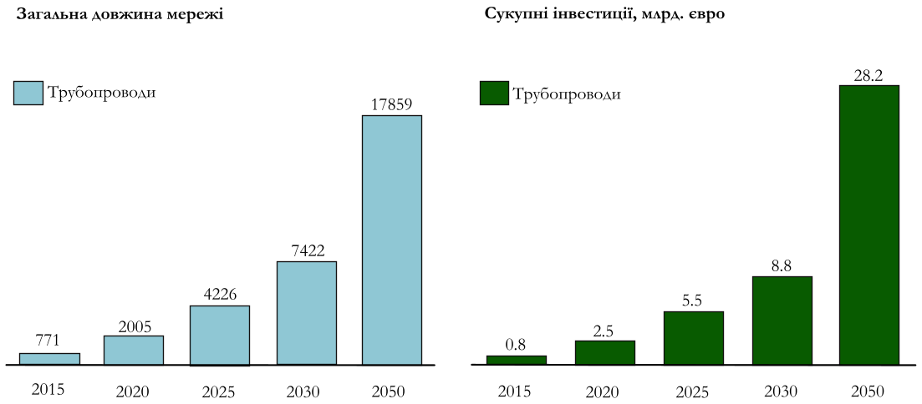
Industrial and Export opportunities (Pipelines)

Slide 35
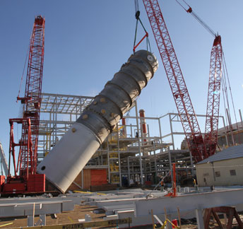
Steel Fabrication

Slide 37
Recommendations for the Ukraine
Include CCS in Industrial policy planning, particularly with regard to the iron and steel industry
Ensure all new fossil power plants are designed and constructed CCS ready (CCSR)
Investigate the possibilities of CCS with biomass and biogas production where Ukraine has a competitive advantage
Create conditions to spur innovation and domestic technology development in CCS technologies
Pilot or demonstration scale CO2 injection projects will be necessary to provide real world data on Ukrainian CO2 storage potential
Ukraine’s extensive gas pipeline network offers many advantages to the deployment of CCS. Re-use of underutilised pipelines may significantly reduce complexity and cost of CCS projects.

Slide 39
Comparative Cost of CCS
Technology | Levelised cost (€/MWh) | Levelised cost (€/t CO2)
Geothermal | 32-46 | -29-0
Hydropower | 39-45 | -20-0
Wind onshore | 51-65 | -6-15
Nuclear | 51-71 | -5-19
Biomass | 61-85 | 7-37
CCS (coal) | 67-105 | 22-69
CCS (gas) | 81-90 | 51-80
Wind offshore | 110-162 | 68-133
Solar thermal | 140-200 | 138-153
Solar photovoltaic | 166-200 | 137-180

Slide 40
