Slide 1


Oeko-Tex® Standard 100 and
STeP – Sustainable Textile Production
Helene Melnitzky, OETI (Vienna) - Greenmind Conference, Kiew 17.10.2013

Slide 2
Introduction
  ÖTI
  Österreichisches
  Institut für Ökologie, Technik und Innovation GmbH, Wien
  Austrian Institute for Ecology, Technology and Innovation Ltd., Vienna
    Founded 1967 as a Carpet Research Institute
    Austrian Textile Research Institute until 2007

Slide 3

Overview of the Institute's Activities
  Accredited testing house according ISO 17025
  OEKO-TEX ® -Labelling and Textile Ecology
  UV-protection to UV-Standard 801
  Personal Protective Equipment - CE marking (notified body)
  Emission testing
  Floor Covering and Interior Decoration – CE marking (notified body)
  Cleaning of Buildings
  Projects / Innovation
  Indoor Air Quality
  Textile testing

Slide 4


OEKO-TEX® Areas
International Association for Research and Testing in the Field of Textile Ecology
(Oeko-Tex®)
Human Ecology – Oeko-Tex® Standard 100
Sustainable Textile Production - STeP

Slide 5
Organisation of the Association
1992
Formation of the Oeko-Tex® Association - OETI, Vienna with Hohenstein Institute in Germany
15 Institutes in Europe and Japan
50 representative/ contact offices worldwide
More than 9500 companies Oeko-Tex® 100
certified in 95 countries
Since 1992 more than 100.000 certificates have been issued

Slide 6
Oeko-Tex® Standard 100
Certification system for textile and textile related products regarding the content of harmful substances
Certification starts with fiber production and ends up in the final product - only modular certification system for textiles
Certification of article groups
Validity of one year – each year renewal is possible
Certificate for communication to third parties
Label with a license number and institute name which can be shown on the product to the end consumer

Slide 7

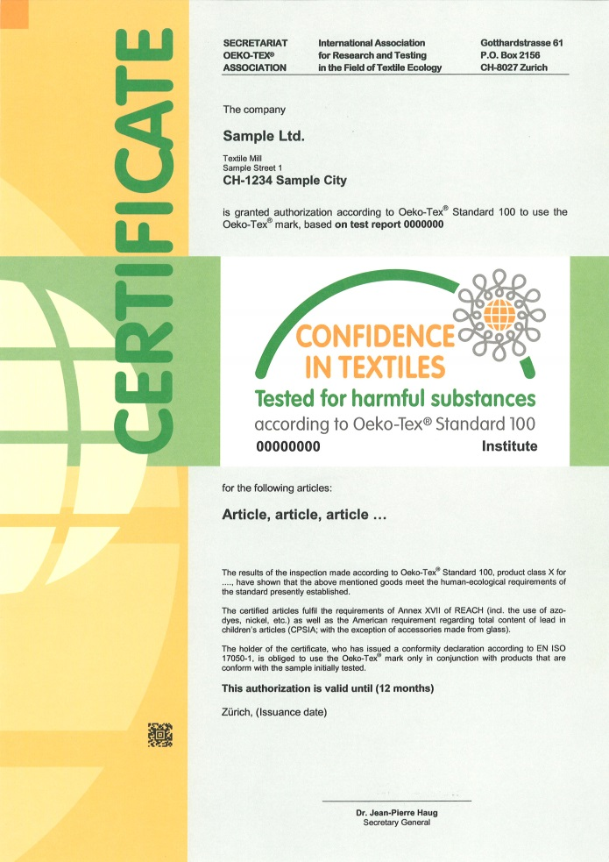

Label / Certificate

Slide 8
Advantages
Safe products – products that are optimised for human ecology help to prevent complaints, offer security in buying preliminary products, and provide a framework for a company‘s own quality management.
Independent – testing for the OEKO-TEX® Standard 100 is only carried out by authorised independent test institutes.
International – the criteria defined for certification provide a standard specifications profile for terms of supply and purchase when buying worldwide.
Widely recognised – the high degree of recognition among end users gives the label the quality of a brand.
A selling argument – certification under the OEKO-TEX® Standard 100, and the security this brings, give the customer added value.

Slide 9

The Vision
More sustainable textile production
To be achieved by:
Protecting the environment
More social and safe workplace
Efficient and economic textile value chain
Total transparency
Benchmarking / Scoring-System

Slide 10

The Challenge
Pollution
Toxic and hazardous chemicals
Insufficient social recognition
Diversity regulatory – textile chain
No transparency
Does a more sustainable production pay off?
Who pays for it?

Slide 11
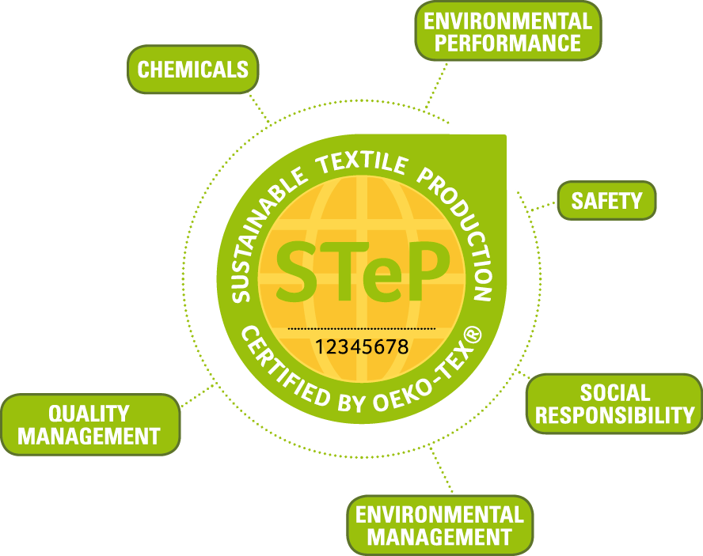

Slide 12
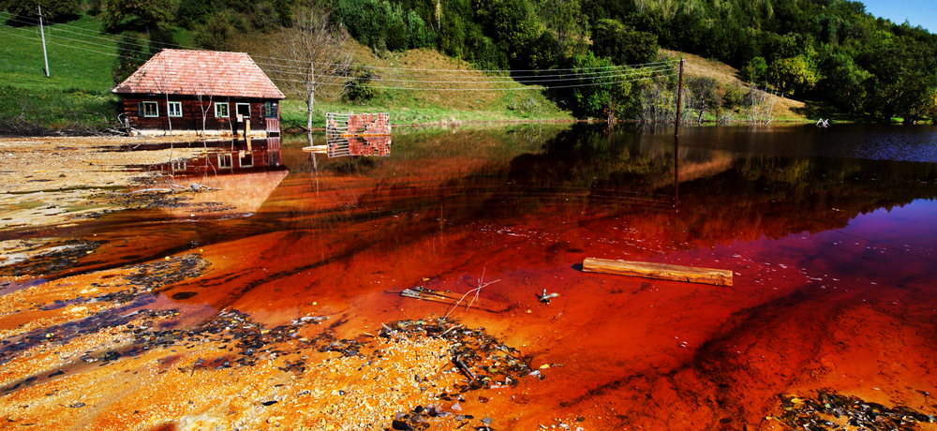
Scope
Chemical Aspects
Chemical management
Advanced RSL list
organized inventory
Towards greener chemistry
  Prevention
  Education
  Information and Monitoring

Slide 13

Scope
Environmental Performance
Efficiency
Limit values
Water, air and waste
Best available technology (BAT)
Cost reduction / optimizing
Carbon footprint

Slide 14
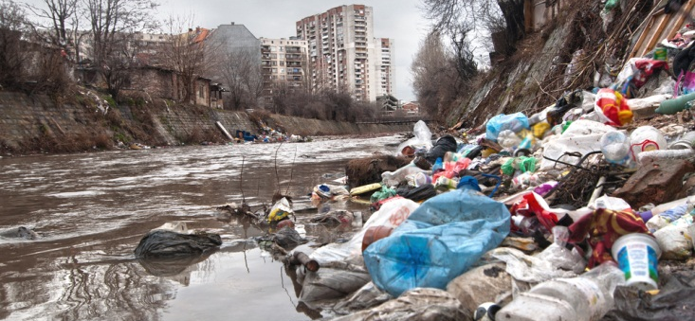
Scope
Environmental Management
IS014001 and others
Legal objectives
Improvement
Prevention
Target setting

Slide 15
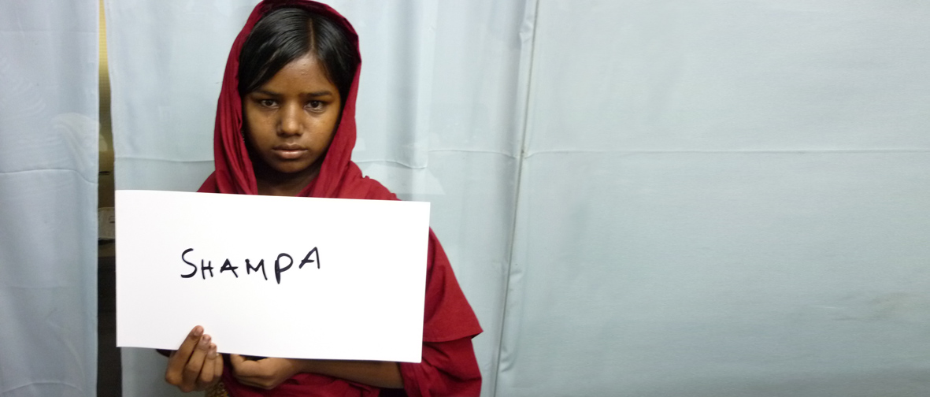
Scope
Social Responsibility
UN and ILO based
Fair wages
Working conditions
Performance review
Recognition of existing social standards

Slide 16
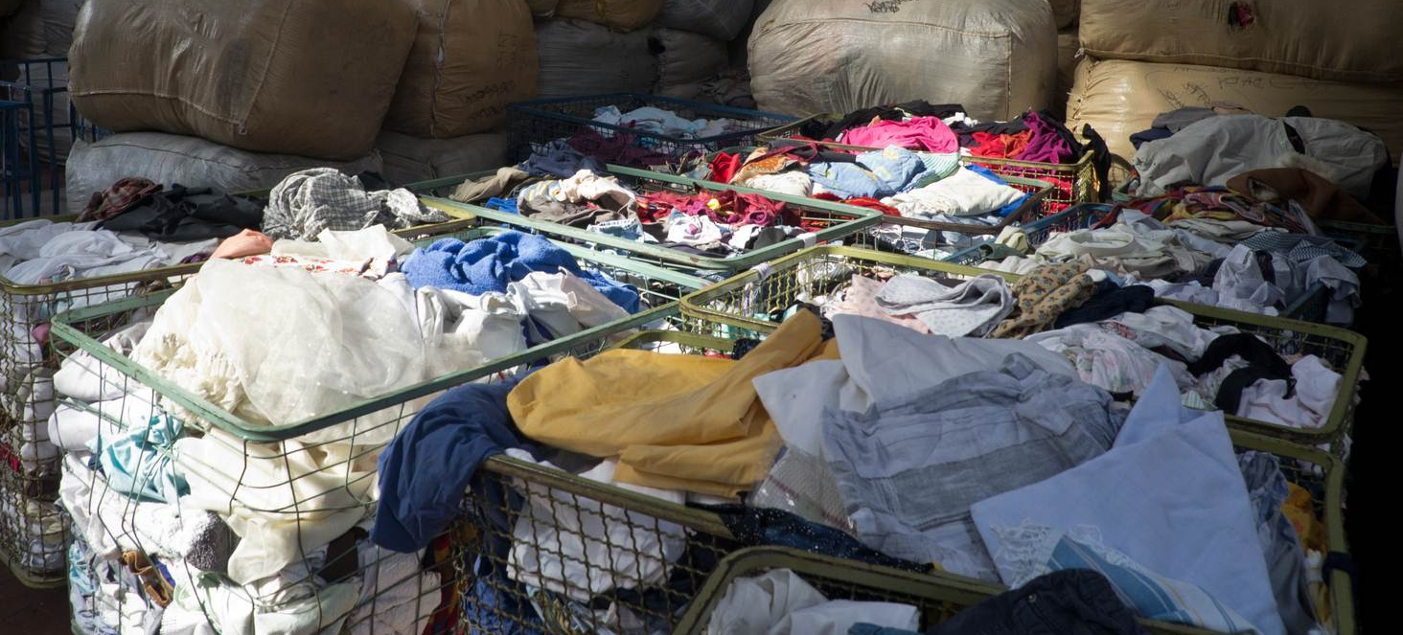
Scope
Quality Management
Based on ISO 9001
Responsibility, documentation, traceability
Risk management
Continuous improvement
Scope

Slide 17

Scope
Safety Aspects
Worker and workplace safety
Occupational health
Facility safety
Risk prevention

Slide 18
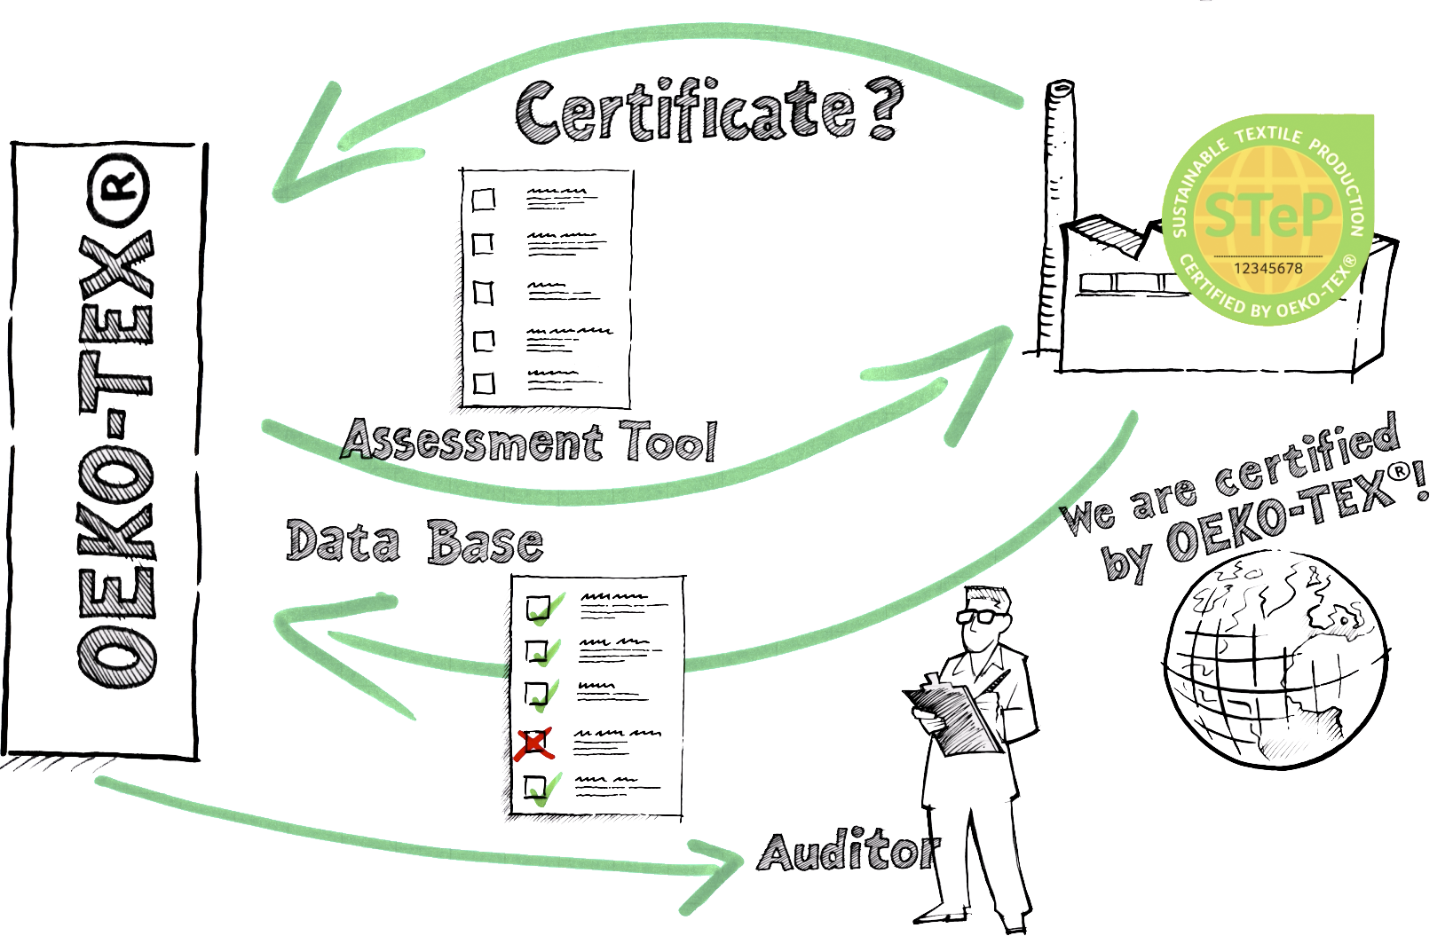

Auditing & Certification
Notes:
18

Slide 19
Scoring

Slide 20

Performance levels
Entry level requirements
Good performance, still room for improvement
Best practice

Slide 21
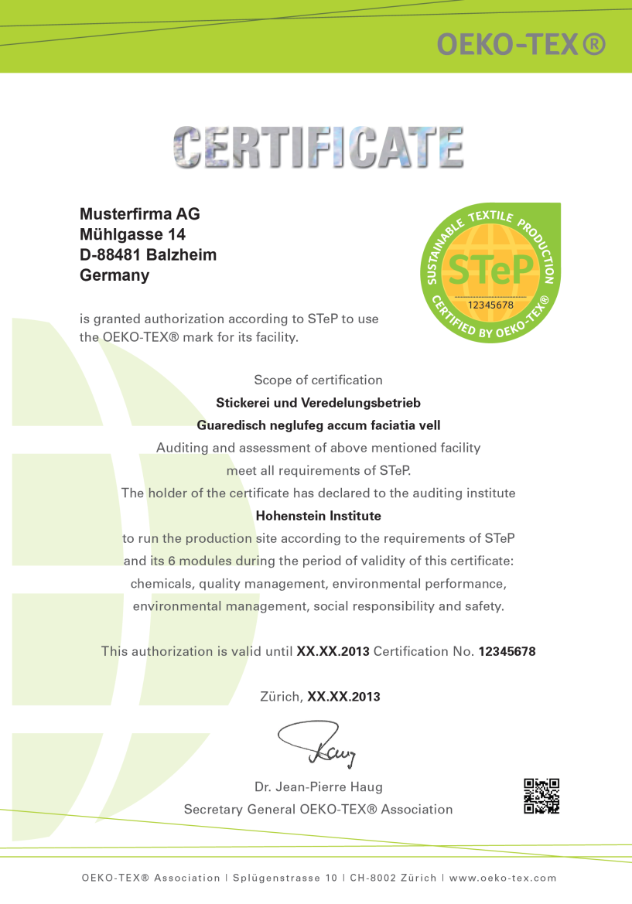
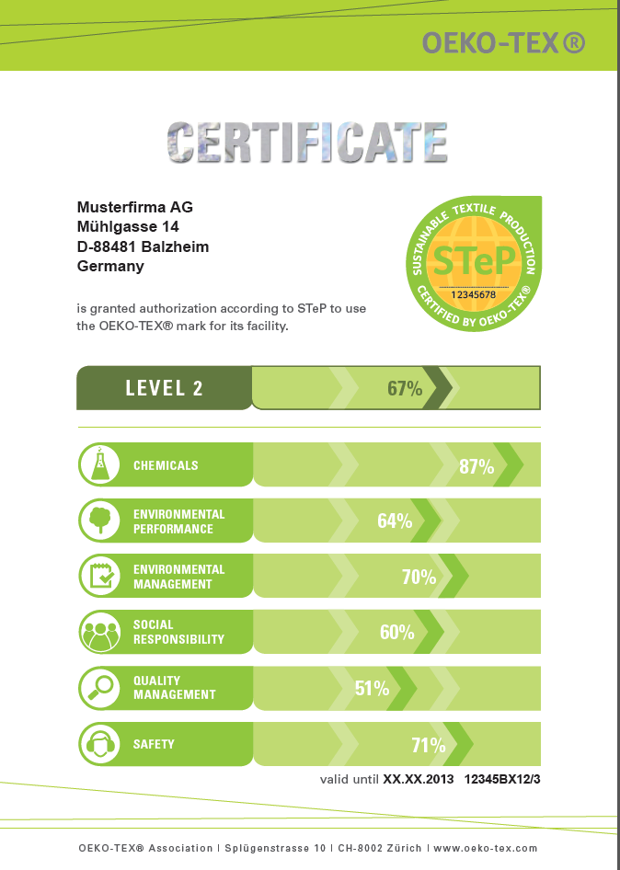

Slide 22
Thank you for your attention
Contact:
Helene Melnitzky
OETI GmbH
Spengergasse 20
A-1050 Vienna
Austria
Phone: +43 69916060817
melnitzky@oeti.biz
www.oeti.biz

